Slide 1
NETFLIX TITLES
ANALYSIS REPORT
GUIDED
BY
NIDHI SHARMA MAM

Slide 2
ANALYSIS REPORT
SUBMITTED
BY
Piyush Upadhyay
Ponnoju karthika Bharani
Pradeep P
Pradeep S
Pramitha P
Pritesh Parmar
Ragavander S
Ravi Malapati

Slide 3
INTRODUCTION
Netflix is one of the leading streaming services worldwide. The Netflix Titles dataset provides a comprehensive list of titles available on Netflix across different countries.
Netflix INC is an American technology. Netflix was founded in 1997 by Reed Hastings and Marc Randolph in Scotts Valley, California.

Slide 4
AIM
We performed four tasks to gain insights into the Netflix Titles dataset.
we analyzed the content library across different countries.
we identified similar content by clustering titles based on text-based features.
we analyzed the network of actors and directors.
we analyzed the trends in content production by Netflix.

Slide 5
DATA DESCRIPTION
The data-set consisted of 8807 Rows and 12 Columns. The columns, and their descriptions were as listed below:
SHOW-ID - Unique id of each show (not much of a use for us in this notebook)
TYPE - Show category. Could be either a Movie or a TV Show
TITLE - Name of the show
DIRECTOR - Name of the director(s) of the show
CAST - Names of Actors/ Actresses in the show
COUNTRY - Countries where the show is available to watch on Netflix
DATE ADDED - Date when the show was added on Netflix
RATING - Show rating on netflix
RELEASE YEAR - Release year of the show
DURATION - Time duration of the show
LISTED IN - Genre of the show
DESCRIPTION - Brief insight into what the show is about

Slide 6
DATA CLEANING
Data cleaning is the process of fixing or removing incorrect, corrupted, incorrectly formatted, duplicate, or incomplete data within a dataset. Here we face lots of null values which converted into “Not Mention”.
We split listed in column by comma which generate 2 new columns.

Slide 7
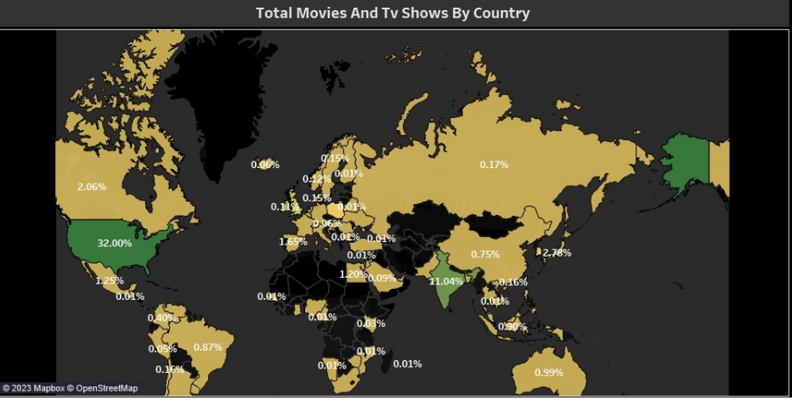
DATA ANALYSIS
Understanding what content is available in different countries
The above map chart are showing how many content are produces by each country. From the graph we can clearly see that USA is producing 32% of content out of total which make country majority of content producer and 2nd is the India which is giving 11.04% content.

Slide 8
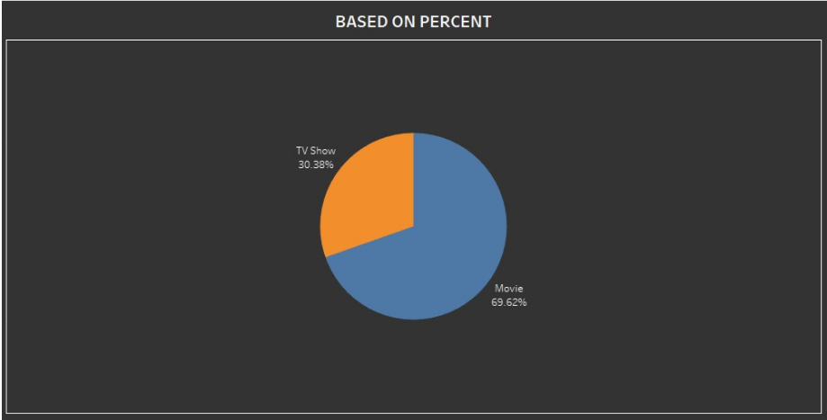
There are total 8807 content data we have In which 2676(30.38%) are TV shows and 6131(69.62%) are movies.

Slide 9
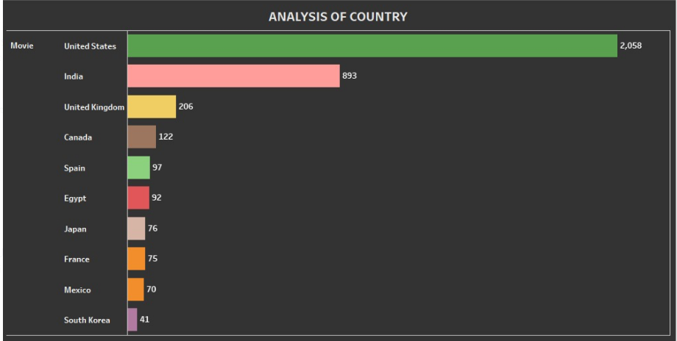
The above list chart is showing top ten country according to number of movies they produce. Here USA is producing 2058 movies which is more than a double then the 2nd country who is producing 893 and India is 4 times more movies than the 3rd UK.

Slide 10
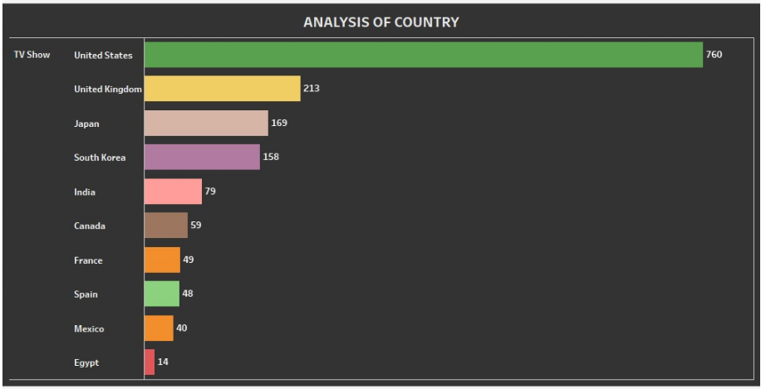
The above list chart is showing top ten country according to number of TV shows they produce. Here USA is again 1st by producing 760 shows. 2nd is UK by producing 213 shows and Japan is 3rd by producing 169 shows.

Slide 11
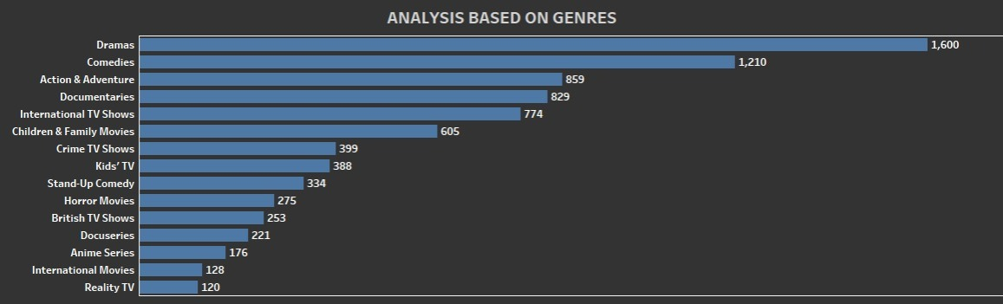
Q2 Identifying similar content by matching text-based features
Here above bar chart is showing us top 15 genre which Netflix is producing. Netflix is making majority of its shows are Dramas, 2nd is comedy and 3rd is Action & Adventure.

Slide 12
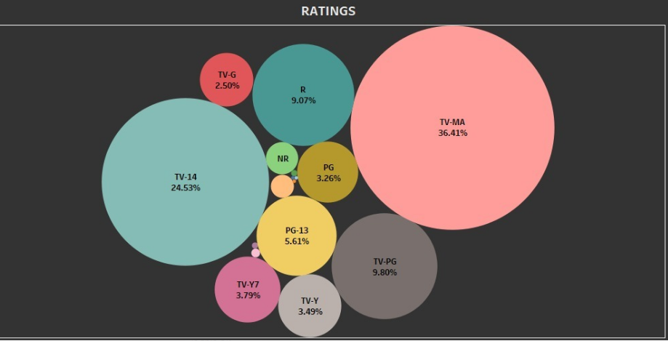
Here above is a bubble chart of rating of Netflix shows. Out of 17 rating type Netflix is making TV-MA rating shows 36.41%, 2nd is TV-14 which is 24.53% and 3rd is TV-PG by 9.8%.

Slide 13
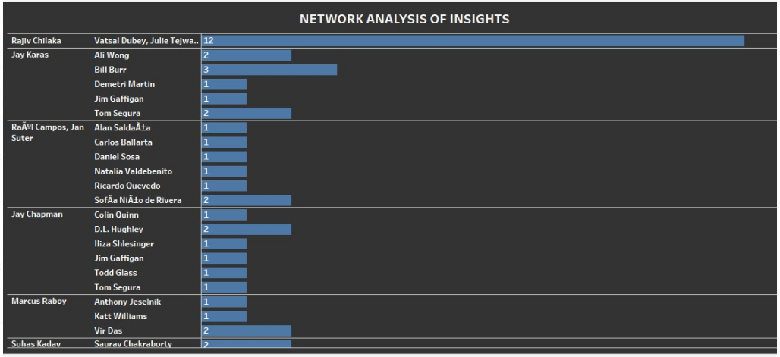
Q3 Network analysis of Actors / Directors and find interesting insights
Here above chart is showing director and actor number times they work together. From the chart we observe that Rajiv chilaka and vatsal dubey and his team worked together for 12 times. And most of the other director and cast are working together are 1 to 3 times.

Slide 14
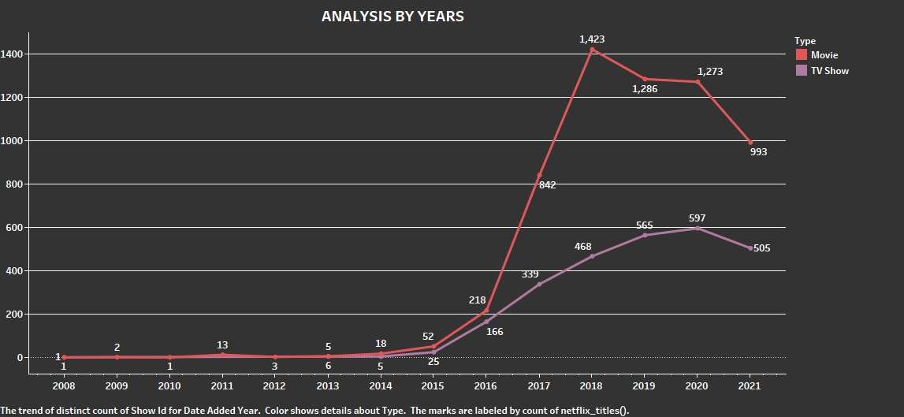
Q4 Does Netflix has more focus on TV Shows than movies in recent years
Here above we have time line chart which shows how many movies and TV shows are producing every year. We have data from year 2008 to 2021 and from the graph we can clearly see that as the number of year increases movies and TV shows are releases more and more. After 2018 Netflix decreases there movies from previous year and continue to producing tv shows. Due to covid situation both category has fallen in number of release.

Slide 15
CONCLUSION
Based on the visualization and text analysis of the Netflix data, it can be seen that movies have a larger part in the Netflix content. Furthermore, the data summaries and visualization indicated that Netflix started contributing it Content since 2008 and United states was the only country back in time. Moreover, Netflix movies and TV shows are rated and these ratings are standardized for different audience. From duration and ranting categories analysis it can be seen that movies which children can watch, on average are shorter.

